Slide 1
Macro Economic Concepts
1.National Income, Meaning, Measurement, Concepts
2.Inflation, Causes, Types.

Slide 2
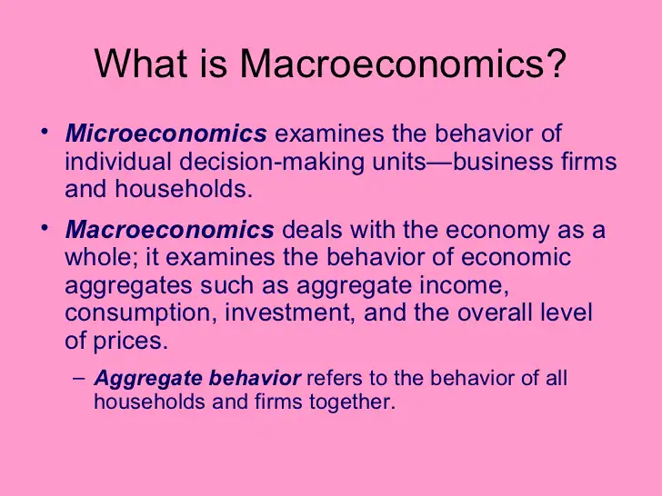

Slide 3
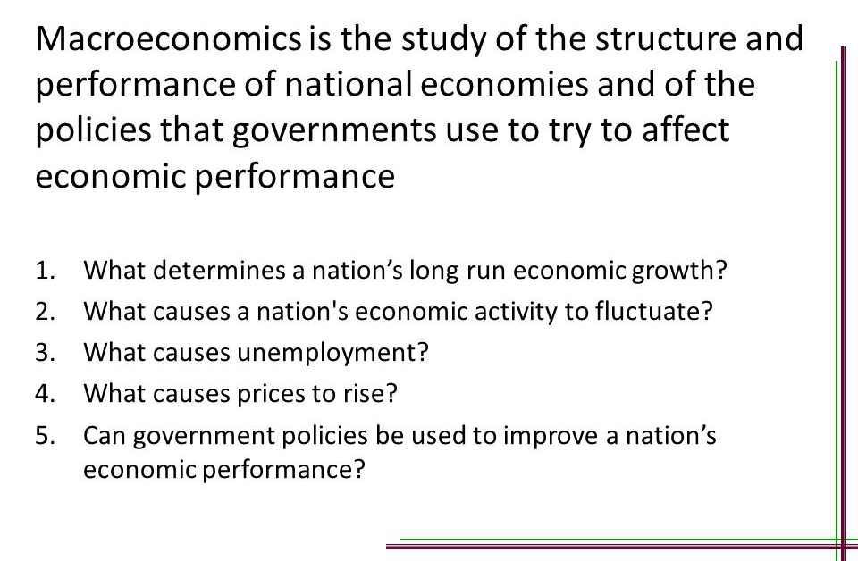

Slide 4


Slide 5
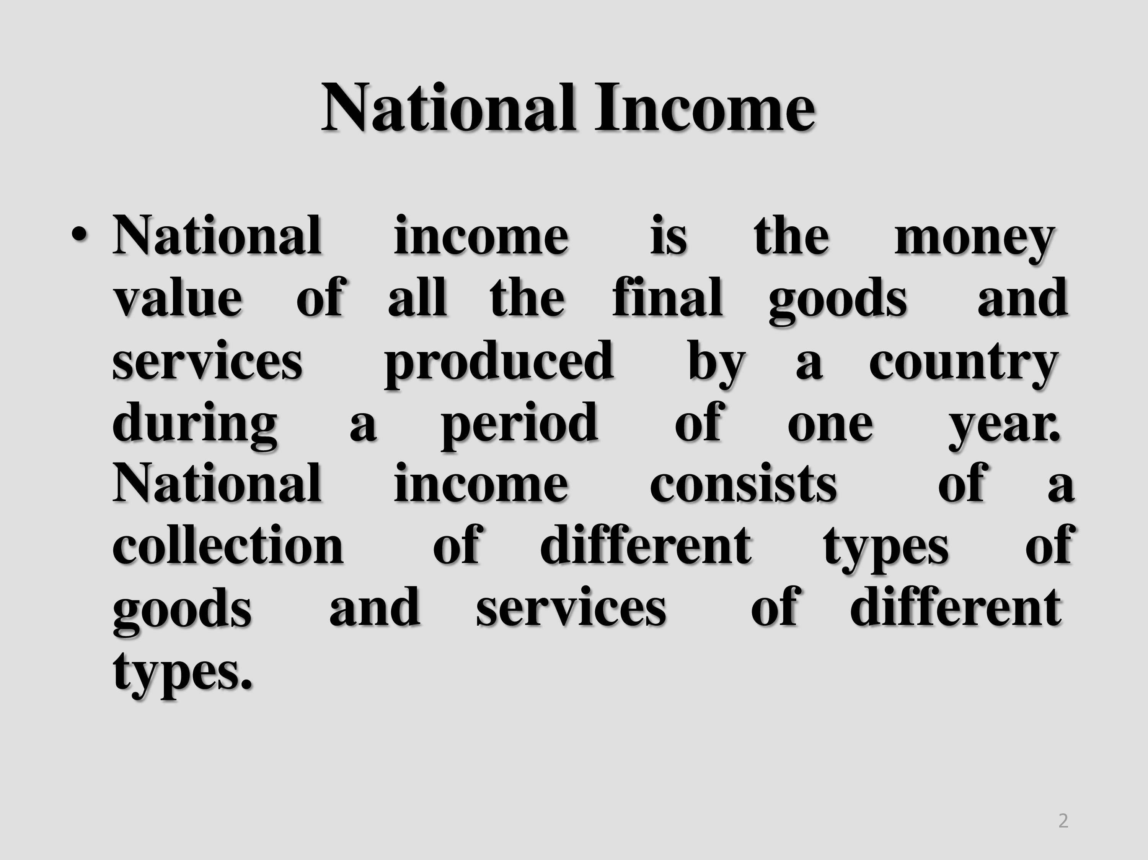

Slide 6
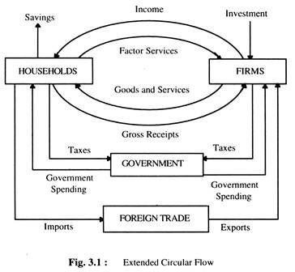

Slide 7
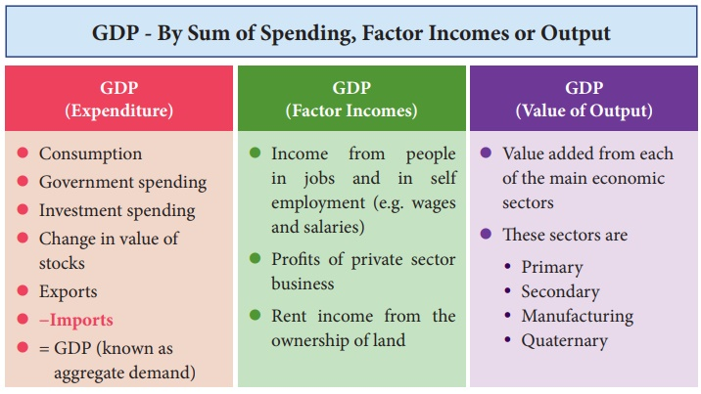

Slide 8
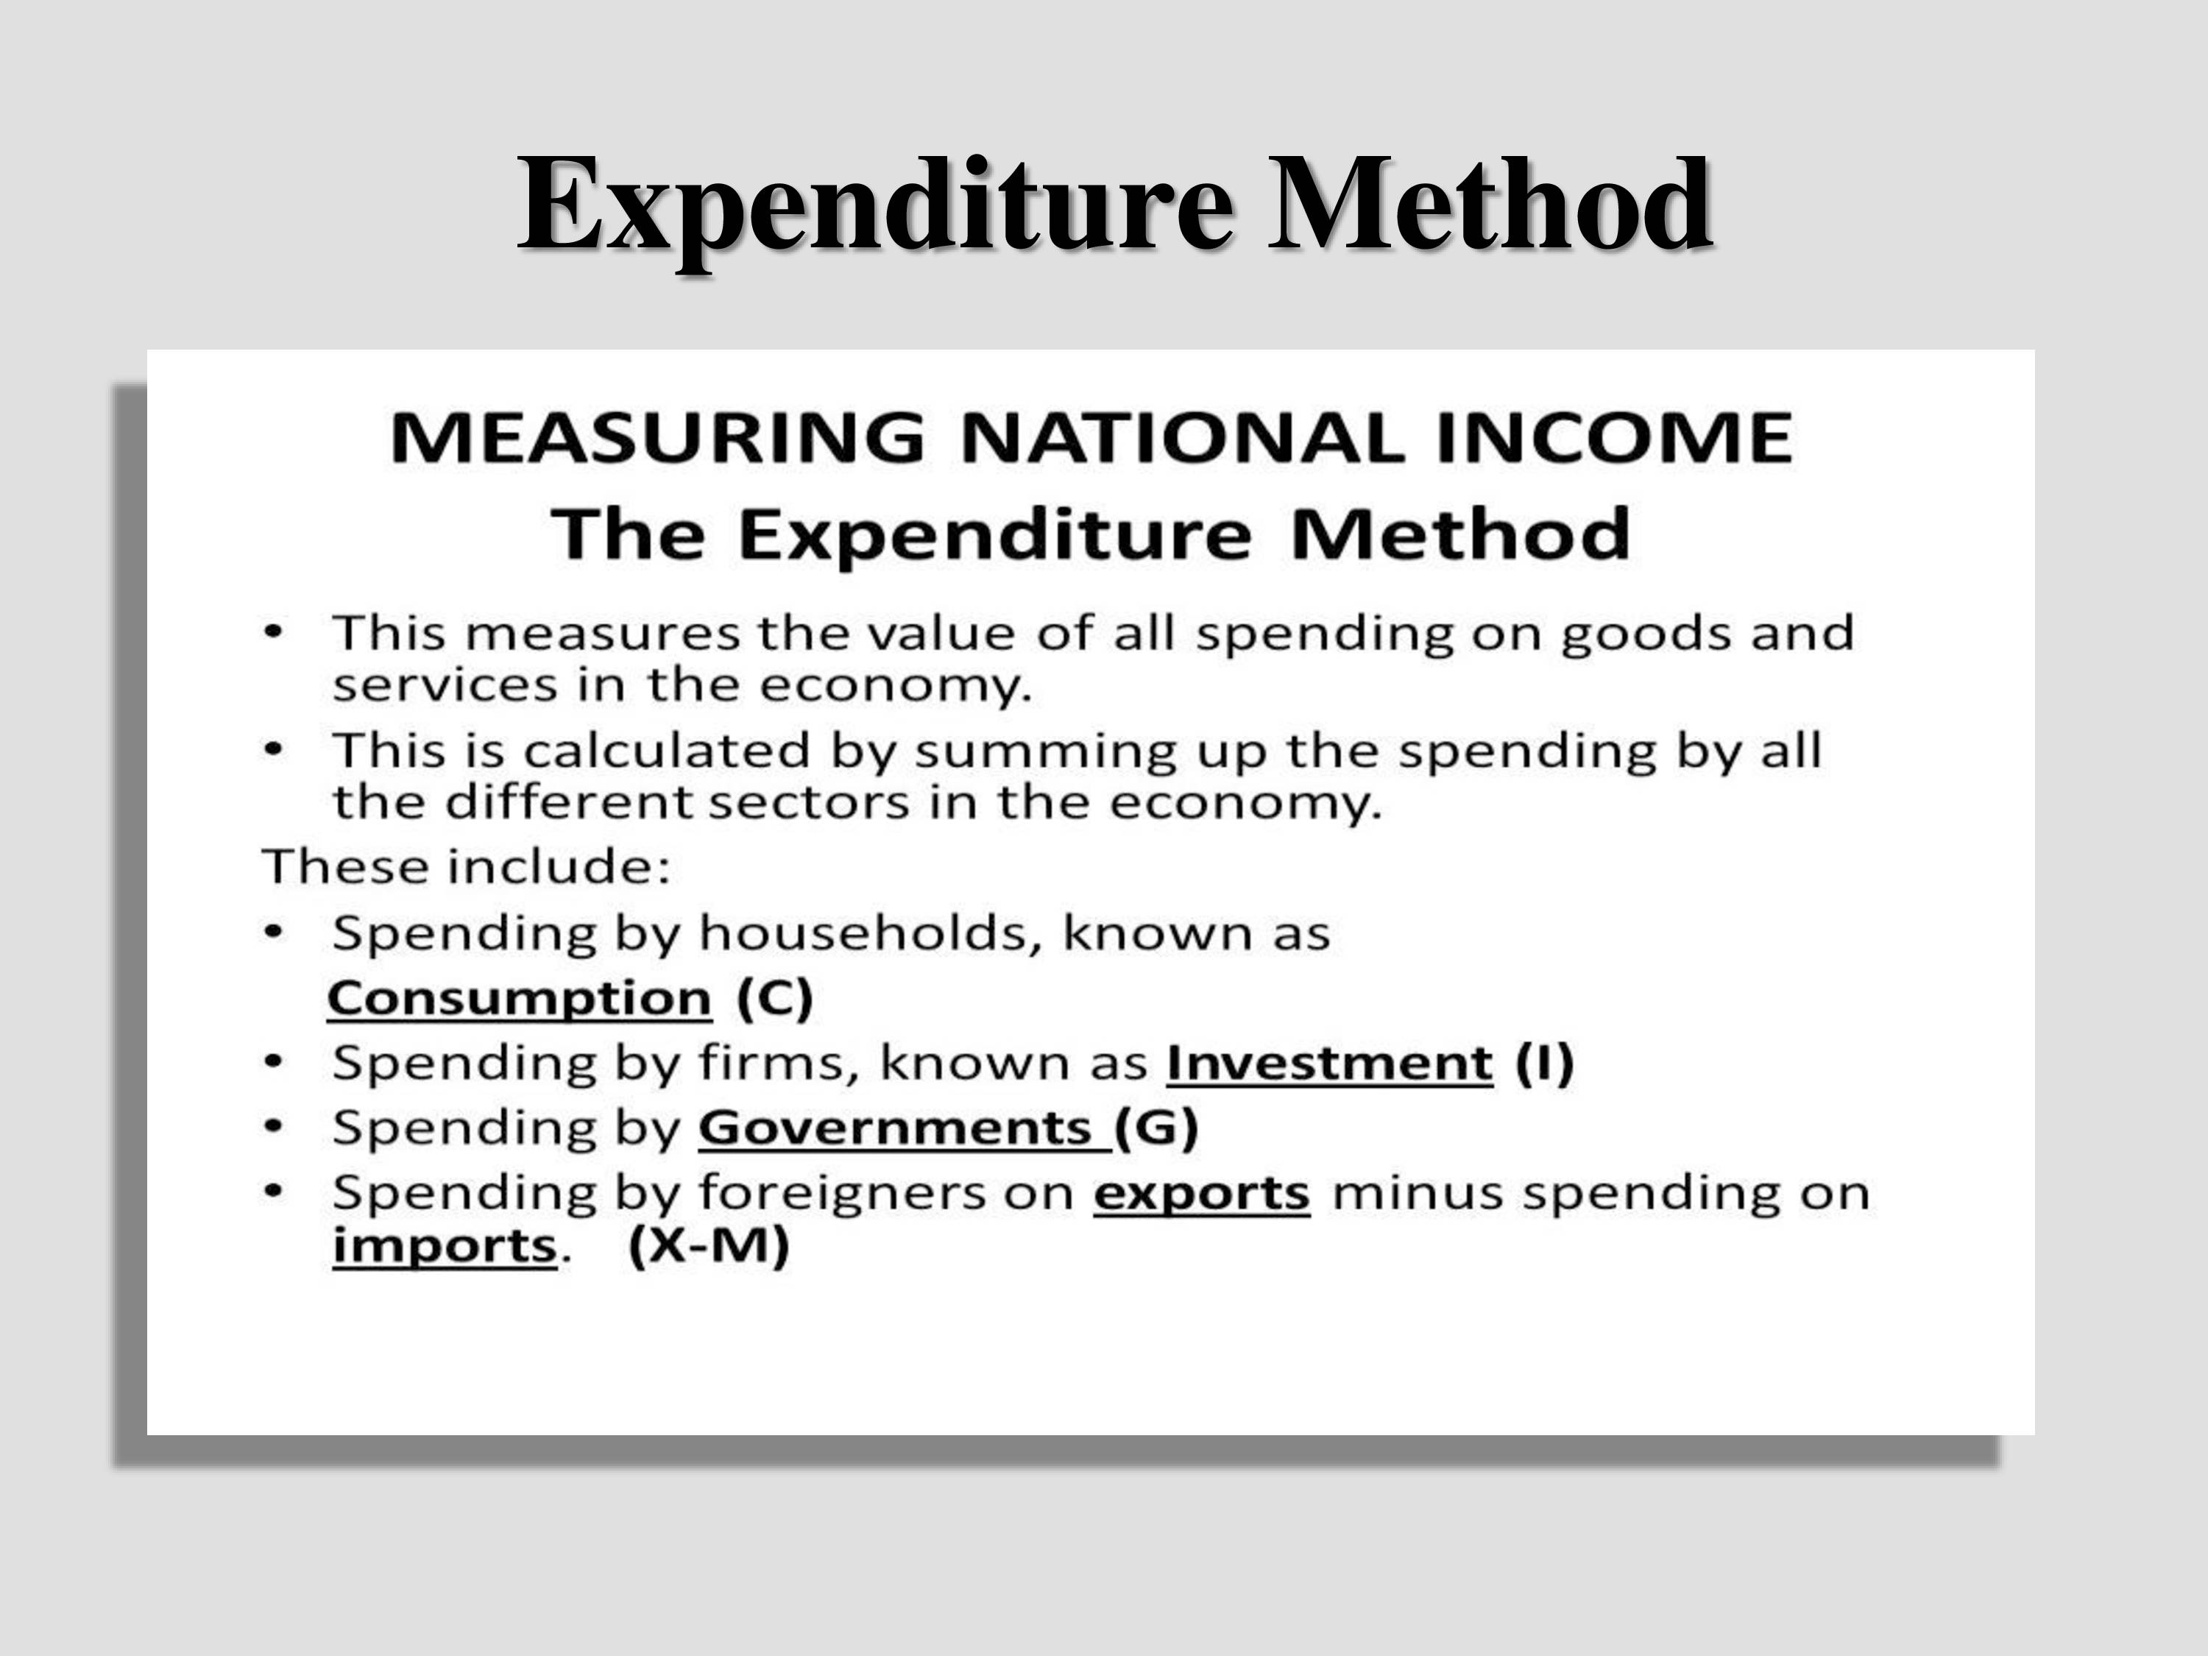

Slide 9
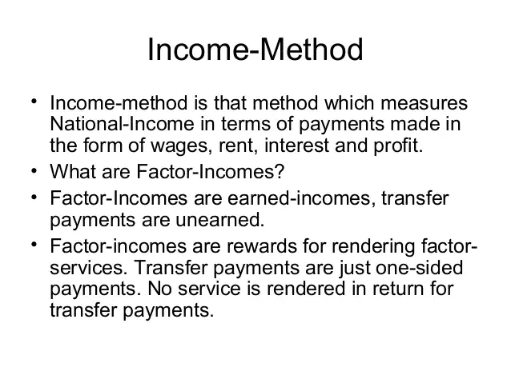

Slide 10
Transfer Payments
A payment made by the government to individuals for whom there is no economic activity is produced in return.
Example: Old age pension, scholarship

Slide 11
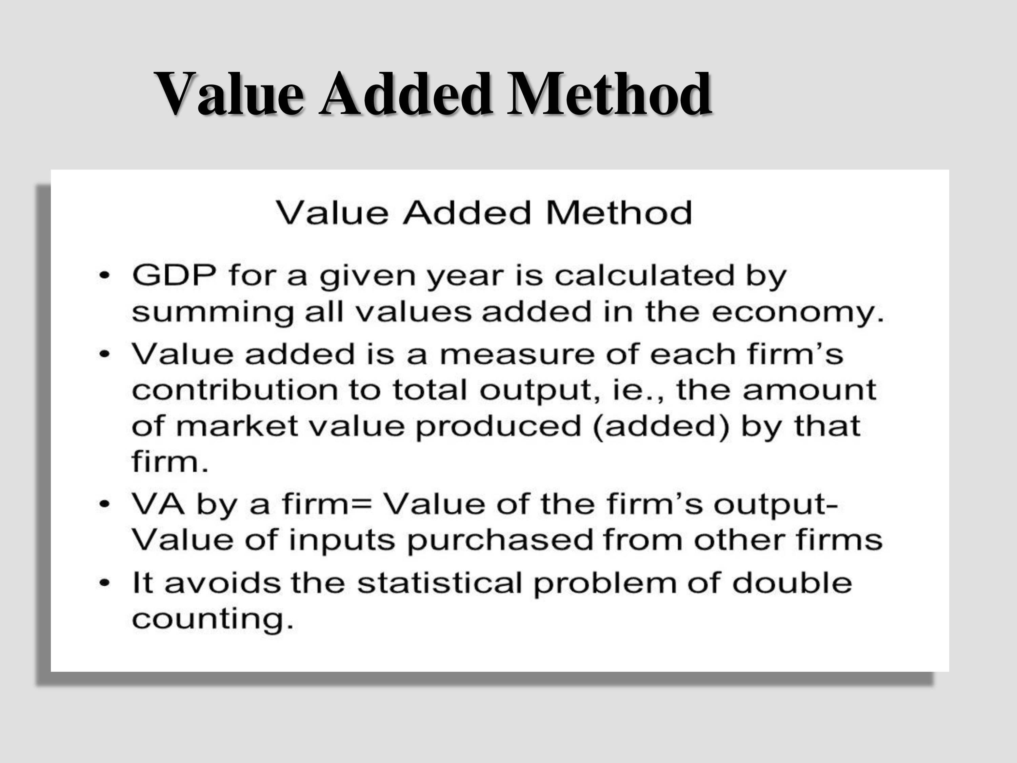

Slide 12
National Income Concepts
1. Gross Domestic Product (GDP)
2. Gross National Product (GNP)
3. Net Domestic Product (NDP)
4. Net National Product (NNP)
5. Personal Income (PI)
6. Disposable Income (DI)
7. Per Capita Income

Slide 13
GROSS DOMESTIC PRODUCT
GDP is the sum of money values of all goods and services produced within the domestic territories of a country during an accounting year. However, it does not include the earnings of national working abroad as also of foreign nationals working in our country. It includes income from exports and payments made on imports during the year.

Slide 14
GROSS NATIONAL PRODUCT
Here the word national is the citizens of a country. GNP is the aggregate final output of citizens and businesses of an economy in a year
GNP=GDP+ NFIA
National factor income from abroad is the difference between net income received from abroad for rendering factor services and income paid towards services rendered by foreign nationals in the domestic territory of a country.

Slide 15
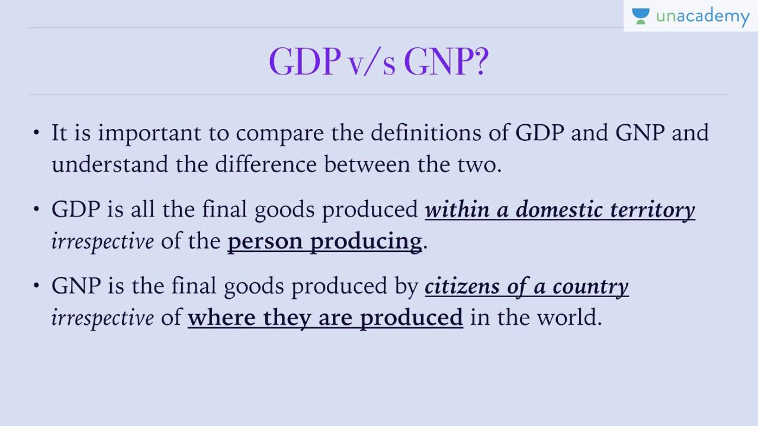

Slide 16
NET DOMESTIC PRODUCT
It is calculated GDP after adjusting the value of depreciation. NDP of am economy is always ;lower than its GDP, since their depreciation can never be reduced to zero.
NDP= GDP- Depreciation

Slide 17
NET NATIONAL PRODUCT
It is calculated by subtracting depreciation from Gross national product.
NNP= GNP- depreciation
This deduction is done because a part of current produce goes to replace the depreciated parts of the products already produced. This part does not add value to current years total produce.

Slide 18
Personal Income
It refers to the income collectively received by all of the individuals or households in a country. It includes compensation for a number of sources including salaries, wages and bonus received from employment or self employment; dividends and distributions received from investments; rental receipts from real estate investments and profit sharing from business.

Slide 19
Disposable income
It means the actual income which is available to be spent on consumption by individuals and families.
Disposable income= Personal income- Taxes

Slide 20
Per Capita income
The average income of the people of a country in a particular year is called per capital income.
In simple words, it is income per head of a country for a year
National Income
Percapita income= --------------
total population

